Slide 1




Reinforcement Learning for a Resilient Electric Power System
Prof. Alberto Sangiovanni-Vincentelli, UC Berkeley
Prof. Ming Jin, Virginia Tech
Prof. Bo Li, UIUC

Slide 2
Thrust 1

Slide 3
Environment: Power Grid Simulator
Topology components:
• edges—powerlines
• nodes—substations
• injections—supplies & demands
•
Datasets:
• configuration of a power grid including
- initial connectivity
- physical parameters and constraints
- simulation settings
• productions and loads from OPF
Rules:
• termination criteria
• AC/DC power flow calculation
• customized control constraints
Additional Functionalities:
• enabling microgrid isolation
• introducing multiple types of cost

Slide 4
Markov decision process (MDP) formulation
State (S):
All the attributes of a simulated power grid (active power, voltage magnitude, thermal limit…). Full list.

Slide 5
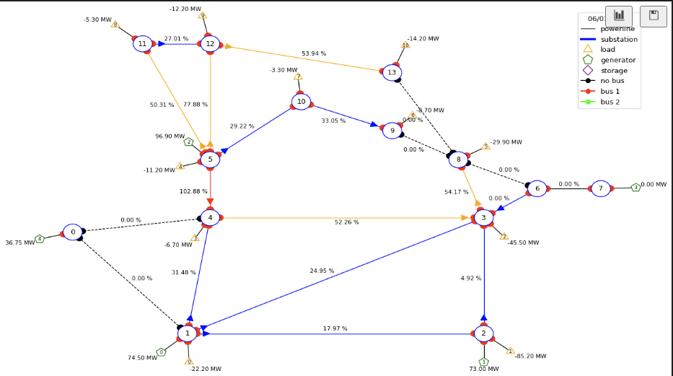
Markov decision process (MDP) formulation
State (S):
All the attributes of a simulated power grid (active power, voltage magnitude, thermal limit…). Full list.
Does not store explicit graph structure.
????

Slide 6
Markov decision process (MDP) formulation
State (S):
All the attributes of a simulated power grid (active power, voltage magnitude, thermal limit…). Full list.
Does not store explicit graph structure.
Represented by a set of vectors that tells what each element of the grid is connected to.
The graph is only computed and presented when requested.

Slide 7
Markov decision process (MDP) formulation
State (S):
All the attributes of a simulated power grid (active power, voltage magnitude, thermal limit…). Full list.
Does not store explicit graph structure.
Represented by a set of vectors that tells what each element of the grid is connected to.
The graph is only computed and presented when requested.
Advantage: performance and flexibility
Can compute the graph into different representations (Ex: connectivity graph, bus flow graph, etc).

Slide 8
Markov decision process (MDP) formulation
Observation:
Most of what the state has in storage, except the chronics dataset itself (Full list).
Can also request other data formats such as connectivity matrix.

Slide 9
Markov decision process (MDP) formulation
Action (A):
Possible actions:
Generators active power production setpoint
Generators voltage magnitude setpoint
Loads active power consumption
Loads reactive power consumption
Change the status of the powerlines (connected/disconnected)
Setting different objects to different buses
Actions directly change the state

Slide 10
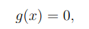
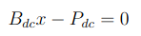
Markov decision process (MDP) formulation
Transition function (T):
Depends on which backend you use.
For Pandapower (default), first put data in a grid (dictionary) object, then runs either DC or AC powerflow. Then converts data back into Grid2op.
DC/AC powerflow are essentially solving a system of equations of the form
Referred to as the power balance equation. For DC, this is a linear system:
Where x are the voltage angles at non-reference buses;
P is the power injection matrix;
B is the system B matrix. (Detailed powerflow calculation)

Slide 11
Markov decision process (MDP) formulation
Transition function (T):
Depends on which backend you use.
In the updated backend Pandapower (resilience), an additional step is performed ahead of the powerflow computation:
Check whether each island has a reference bus
If not, assign a bus with generator as the reference bus

Slide 12
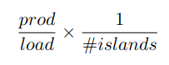
Markov decision process (MDP) formulation
Reward function (R):
Depending on the objective, can have multiple reward function at the same time.
Whether powerlines are overflowing;
Penalty on how many bridges are present in the grid network;
Penalty on amount of change of the grid;
Operation cost (disconnecting a powerline, etc);
…
Our new resilience-oriented reward (with a constant shift):

Slide 13
Thrust 2

Slide 14


Slide 15
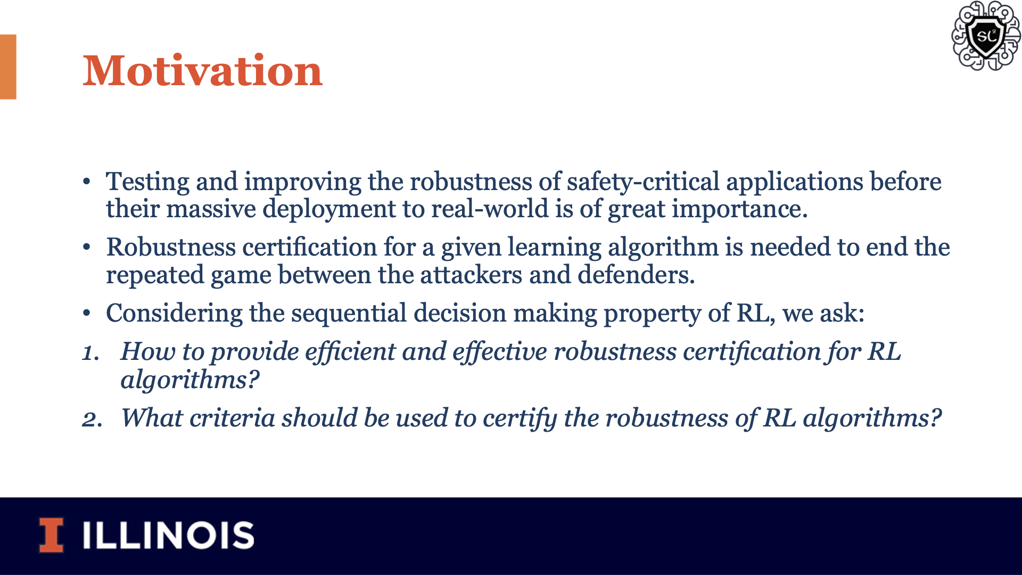

Slide 16
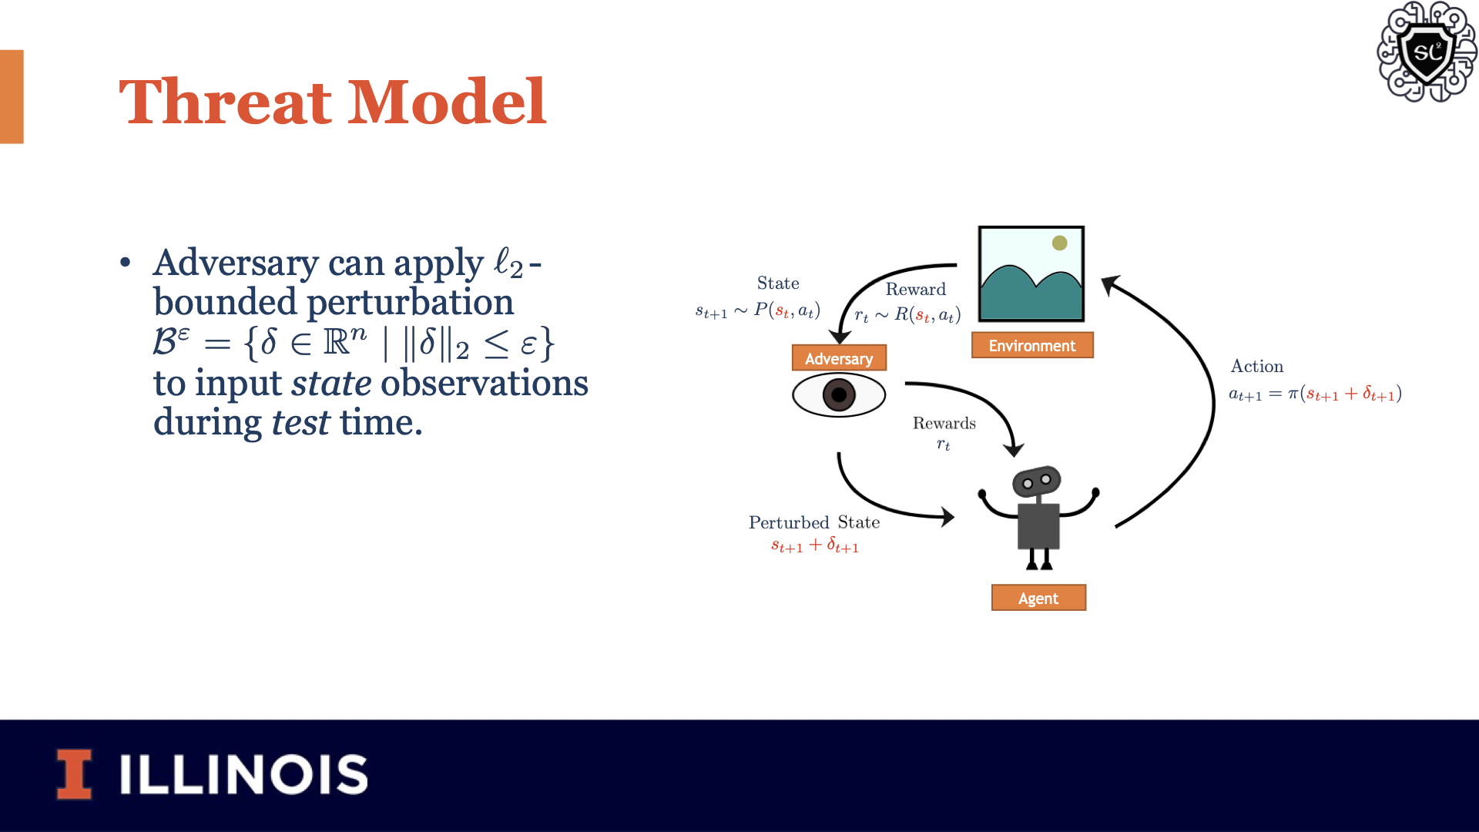

Slide 17
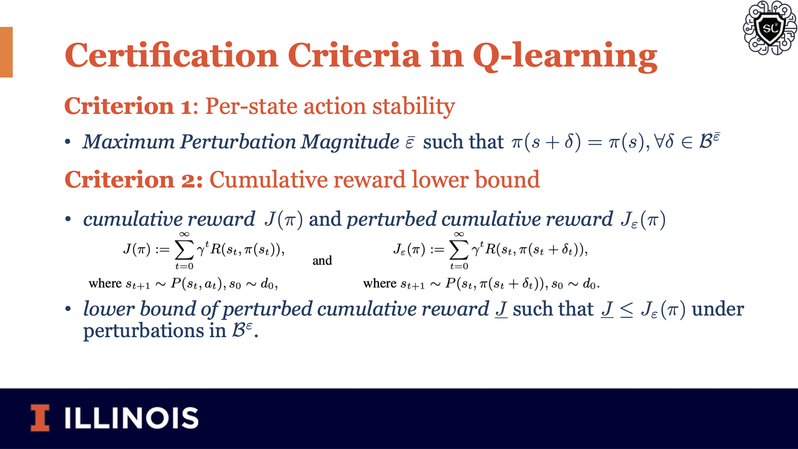

Slide 18
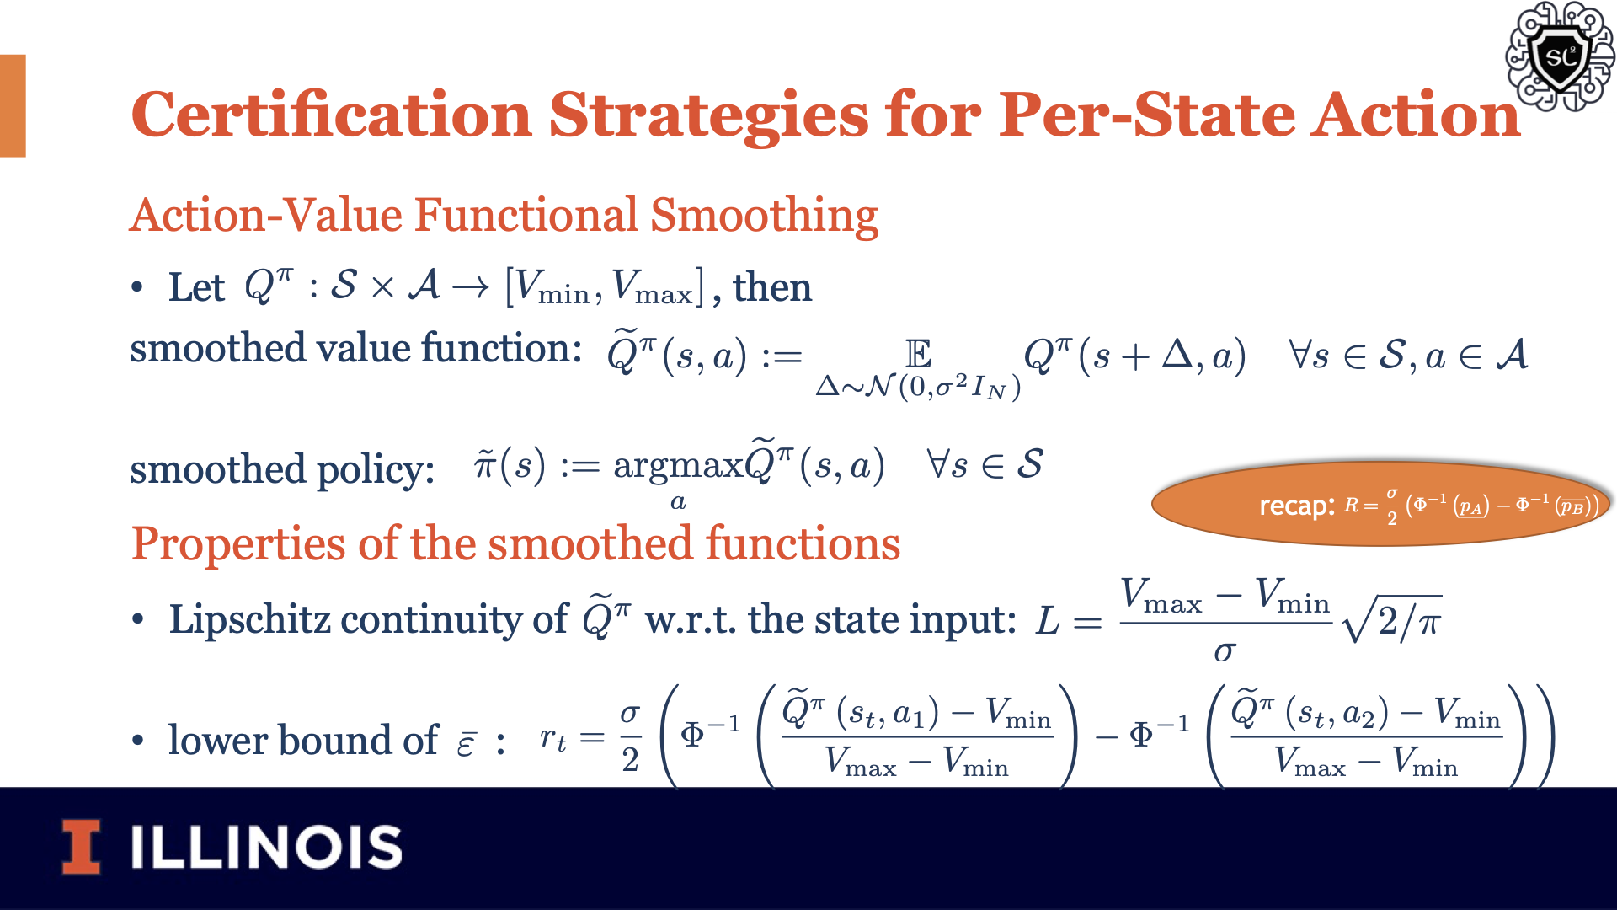

Slide 19
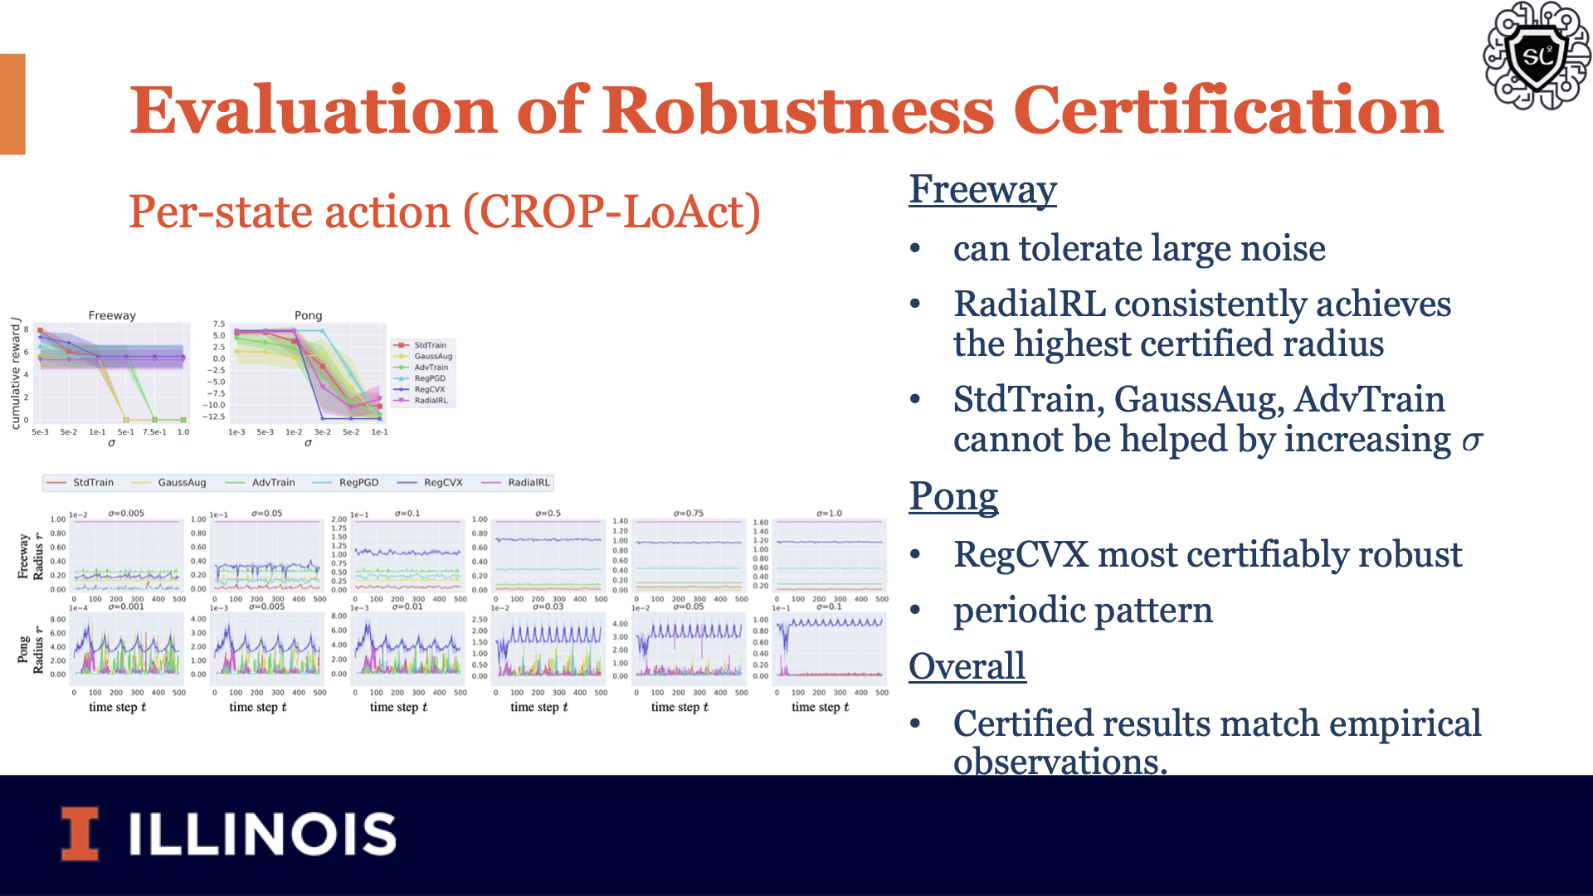

Slide 20
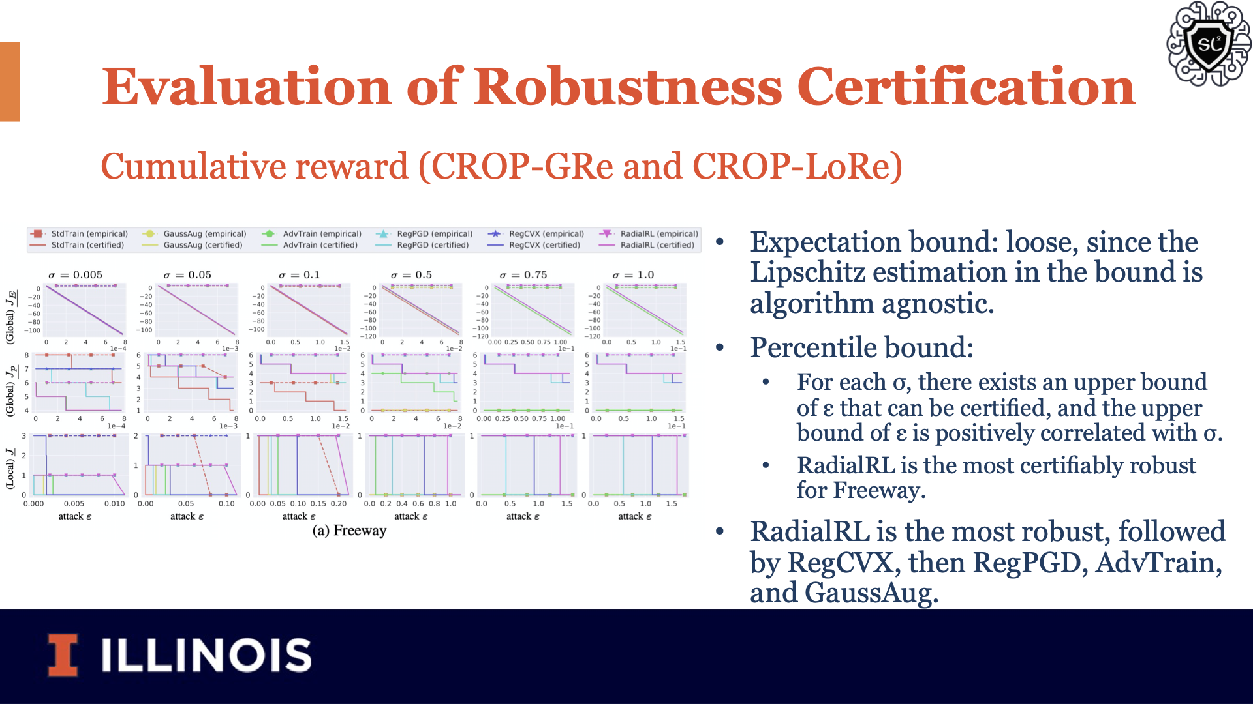

Slide 21
Thrust 3

